Slide 1





Overview Of HIV Proficiency Testing In Eswatini
Mr. Gcina Dlamini. MT
National Quality Assurance Unit – Principal Laboratory Technologist
Eswatini Health Laboratory Services

Slide 2
Presentation Outline
Background & Context
Eswatini PT journey
Our Approach
Some Results
Lessons Learned

Slide 3
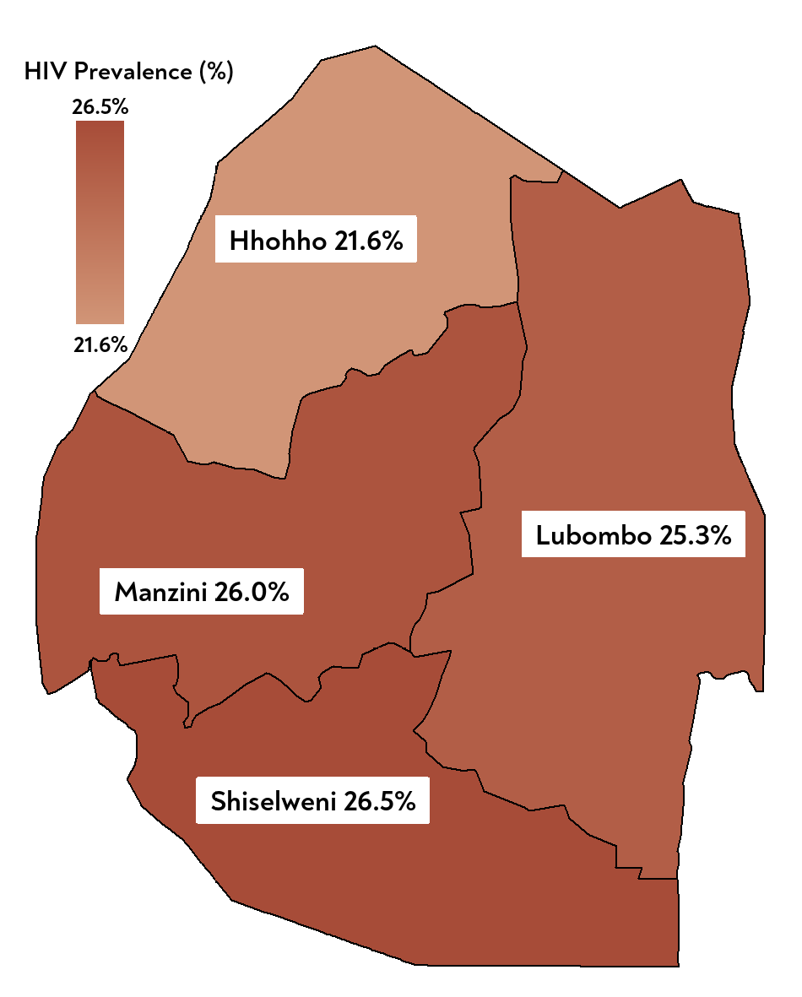
Background
Eswatini HIV RT Quality Assurance Context
In 2006, Swaziland adopted HIV task-shifting and introduced HIV rapid testing (RT) to quickly identify individuals for prevention measures and treatment
To monitor the quality of testing, the country implemented retesting 10% of specimens using ELISA.
However, because of the inefficiency observe with the retesting, the country established a proficiency testing program for HIV RT.
In 2012, dried tube specimens-based proficiency testing was piloted in a few sites before a being scaled up subsequently.
Some facts
Size of Kingdom of Eswatini: 17,364 sq. km
Population: 1.2 million
HIV prevalence among adults (>15yr): 24.8% & HIV incidence: 0.6%
148,782 individuals tested for HIV in 2023
Testing setting: Facility & Community
Multiple testing modalities implemented
323 testing sites: 19 labs, 60 mini labs and +240 testing points
Source: SHIMS 2021 Final Report

Slide 4
Our Proficiency Testing Implementation Journey
09/10 – 06/11
Logistical preparations
07/11
Nationwide sensitization & training of key stakeholders
07/11 – 12/11
Regional training of all facilities
01/12
DTS HIV PT piloted in 67 testing sites
2013
Phased scale up from 45 sites to +300 testing sites
2025
* Nationwide roll out of ePT
* Plans for automating PT panel production
2022-2024
* Expansion of DTS PT to Hepatitis B & Syphilis
* Customization and pilot of ePT for PT data management

Slide 5
Our Stakeholders and Their Role?
EHLS: NQAU
MOH Programs: HIV, TB, SRH, etc.
PEPFAR Funded IPs
  Coordination & oversight
  Design of the PT program
  Development all the tools
  Production of PT panels
  Data management and implementation of corrective actions
  Support to the development of PT roll out plan and implementation
  Assisted with sites sensitization
  Lab IPs: URC, ICAP
    Procurement of the supplies and consumables
    Logistical support with PT panels distribution to the various testing sites
    Technical assistance for PT panels production, data management and corrective actions in the labs
  Clinical IPs
    Support for training and implementation of corrective actions in the non-lab sites
AFENET
DTS technology transfer to EHLS and training

Slide 6
Our PT Methodology
PT Panel Design
Return of Results
Feedback
  Communication of PT calendar every year
  Verification of testing sites information by regional lab coordinators (i.e., new site, active or not, etc.)
  Collection of discarded blood units from blood bank
  Characterization of samples collected
  Preparation of PT packs
  QC of PT packs prior to distribution to testing sites
  Panels distributed four times a year by:
    National sample transport systems (NSTS)
    Dangerous Goods Nurse
  Implementing Partners
  Community HCWs
  Screenshot of results form are sent to NQAU Via WhatsApp
  Hardcopies via NSTS
  TAT: 4 weeks
  Entry of WhatsApp data by NQAU
  Verification of data using hardcopies
  QC of data entries
  Data analysis & scoring
  Report generation
  Feedback report including performance score and areas of improvement sent to testing sites
  Implementation of corrective actions if needed
Site Enrolment
Panel Distribution
Data Management

Slide 7

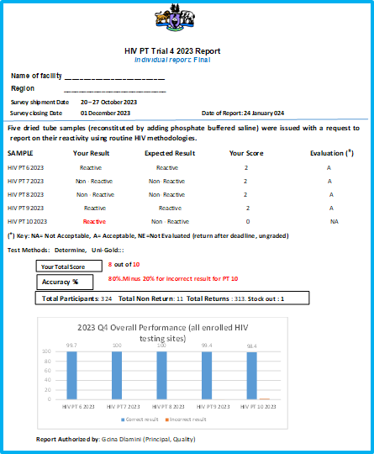
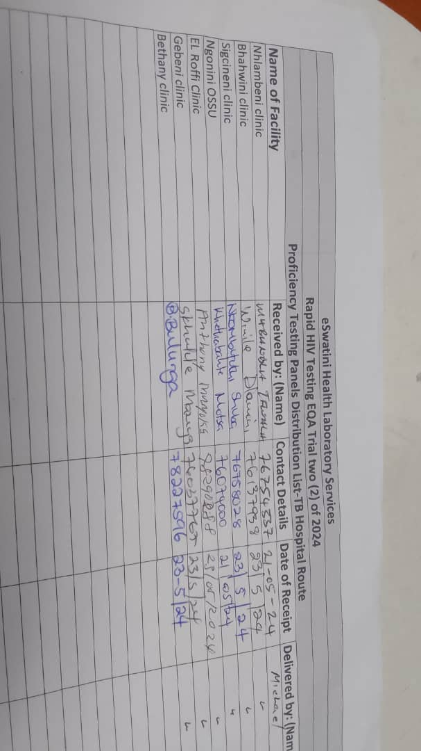
Snapshot of Some of Our Tools
PT Pack composition
5 PT Panel members
1 buffer vial
Droppers
Results form
Instructions
Individual Final PT Report
Current PT Results form
PT panel distribution list provided to couriers
Contact information includes WhatsApp No

Slide 8
Who Are Our PT Program Beneficiaries?
Our HIV rapid testing PT program targets both public and private testing sites in all 4 regions of the country
These include main labs, mini-laboratories, health facility testing points (clinics, hospitals, health centers), and community outreach sites
Health Centers
Correctional Services Clinics
Points of Care Testing Sites (community or health facility)
Armed forces facilities (Police & Army)
Hospitals
Mini Labs

Slide 9
Improved Return and Performance Rates Overtime
PT return rates increased significantly from 71% in 2016 to 98% in 2023, especially after the the introduction of WhatsApp for returning results in 2017.
PT performance rates stayed very high, even with the increase in number of sites enrolled overtime.
Some reasons for not returning results include the following:
  Testing sites closed, particularly during Covid-19
  RTKs stockout
  Unavailability of testers

Slide 10
Reasons for Failure & Corrective Actions Approaches
Sites with unsatisfactory PT performance score (<100%) receive support to implement the corrective actions.
The support is based on the type of corrective actions to be implemented by testing site.
It includes but is not limited to the following:
  Mentorship
  Site supervisory visit
  Onsite re-training, if necessary
    Retesting of PT panels if reason for failure is incorrect final results

Slide 11
What Have We Learned?
Rigorous quality assurance measures are paramount to maintaining the integrity and reliability of PT activities.
PT program should be adaptable to the evolving needs and advancements in testing methodologies, algorithms, and technologies.
Establish mechanisms for feedback and dialogue between stakeholders to address challenges and improve program effectiveness continually.
Effective communication and continuous education are essential for ensuring understanding and compliance of participating laboratories and lab and testing points.

Slide 12
Acknowledgements
Ministry of Health various programs
PEPFAR-Eswatini
PEPFAR funded partners: URC, ICAP, PSI
TASC
Laboratories and testing points
AFENET

Slide 13
SIYABONGA
THANK YOU
GRACIAS
MERCI
ABRIGADO

